Slide 1
ME 766 Course Project
Analysis of Parallel Computing Techniques for Time History Analysis

Slide 2
Problem Statement
To find out Time History Data of Spring Mass System

Slide 3
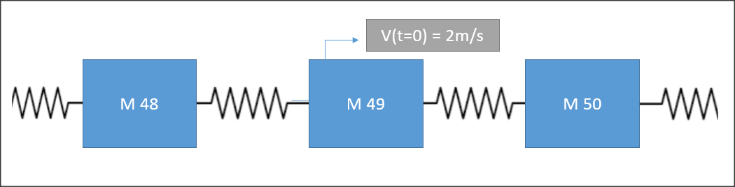
The problem
Mass | 1Kg
Stiffness Constant | 1000N/m
V(t=0) for 50th Mass | 2m/s

Slide 4
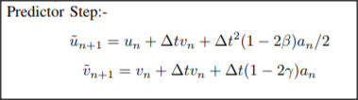
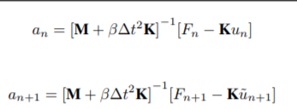

Solution Methodology
Solution Scheme | 𝛽 | ℽ
Explicit | 0 | 0.5
Implicit | 0.5 | 0.5
Corrector
Step

Slide 5
Implicit Execution
For Implicit Implementation, we need to Find Inverse of a Tridiagonal Matrix
Computationally Expensive but Unconditionally Stable

Slide 6
Explicit Execution
Based on Predictor - Corrector Approach
Computationally Feasible but Conditionally Stable

Slide 7
Solution Methodology - Serial Code
Initialization of Arrays
Predictor Loop
Updating a[ i ]
Time Loop
Corrector Loop
Printing Values
Updating Arrays

Slide 8
Solution Methodology - CUDA
Initialization of Arrays
Copying Data to GPU
Launching Kernel
Predictor Step
Calculation of a(tn+1)
GPU
Corrector Step
(printf)
Update Values
N Threads

Slide 9
Solution Methodology - MPI
Initialization of Arrays
P
P
Thread - 0
0 - 24
Thread - 1
25 - 49
U
U
C
C
Time Loop
P
P
Data Sharing Across Arrays
Thread - 3
75 - 99
Thread - 2
50 - 74
U
U
C
C

Slide 10
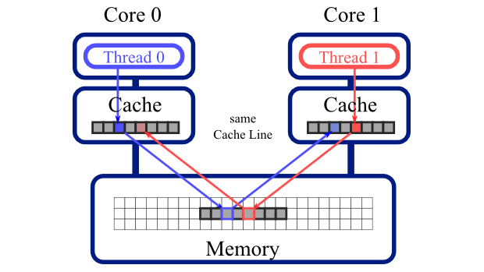
Solution Methodology - OpenMP
Solution process is same as compared to serial code.
Each ‘for’ loop is parallelized among 4 threads. (except at some places where parallelization is not possible due to data dependency)
To minimize false sharing between threads and increase speed further, we have increased dimension of array using PAD variable
False sharing between threads of different core-

Slide 11
Solution Methodology - OpenMP
So, when we increased dimension of each array, each data element will be stored in first column of each row of the matrix. Number of columns will be equal to PAD variable. PAD variable is basically cache line size.
Since, in c++ language, matrix is stored in row wise fashion, so each data element will lie on different cache memory since each data element lies on first column and number of elements in each rows are same as cache memory size.
By this method we can avoid false sharing in the OpenMP.

Slide 12
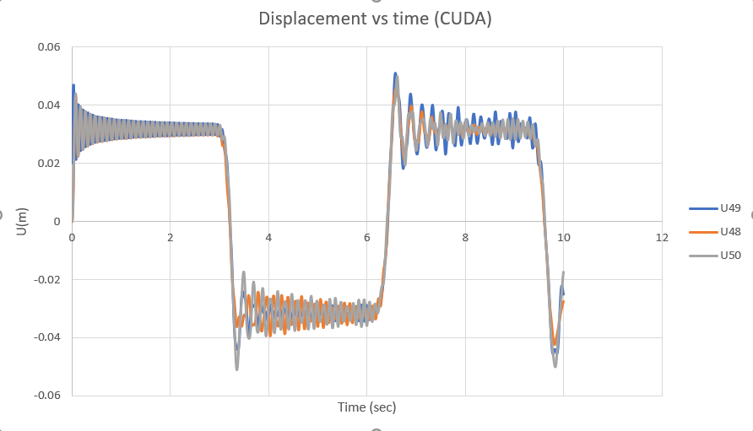
u(t) Vs time
Comparison of Results

Slide 13
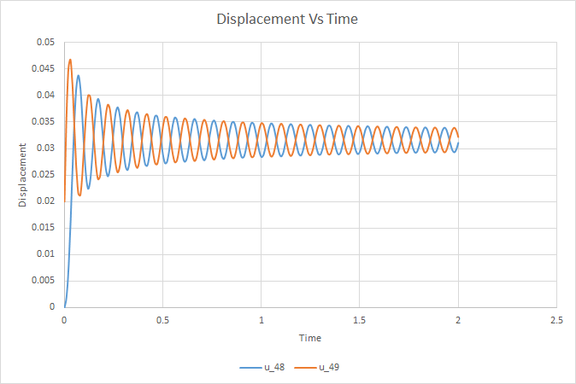
Results
Physical Interpretation
Displacement of masses follow sinusoidal path
Displacement of adjacent masses is opposite to that of 50th Mass

Slide 14
Time Study
CODE | Time(s)
MPI | 0.02653145
CUDA | 0.1339292
Serial(Func) | 0.2039362
OpenMP(Func)(4 threads) | 0.662123
Serial Code - Functions for Matrix Vector Operations
MPI and CUDA - Updating a[i] values of Arrays

Slide 15
Challenges
CUDA
Ensuring Code has Minimal Kernel Launches
Ensuring Minimal Number of Data Transfers
MPI
Synchronisation Between Threads
Ensuring Minimal Communication Between Threads
OpenMP
Ensuring minimum number of loops are present for parallelization
Tried to see effect of removing false sharing

Slide 16
Challenges
Implicit
Devising Function to Calculate Inverse of Tridiagonal Matrix
Flattening 2D Array to pass into functions

Slide 17
Improvements Possible
CUDA - We can launch Kernel inside a kernel to execute Time Loop.
For Large DOFs shared access in kernel can be implemented.
Implicit CUDA for Large DOFs gives erroneous data
MPI - Needs to be generalized to cases when the DOFs and Number of Threads are not divisible
OpenMP - Need to restructure code to minimize formation and destruction of threads.

Slide 18

Thank You
Name | Roll No
Akash Padmane | 150100034
Shreyas Gaikwad | 150100016
Ashish Kumar | 150100080
Anurag Gupta | 15D110023
Saurabh Bhalerao | 150100035

